Slide 1
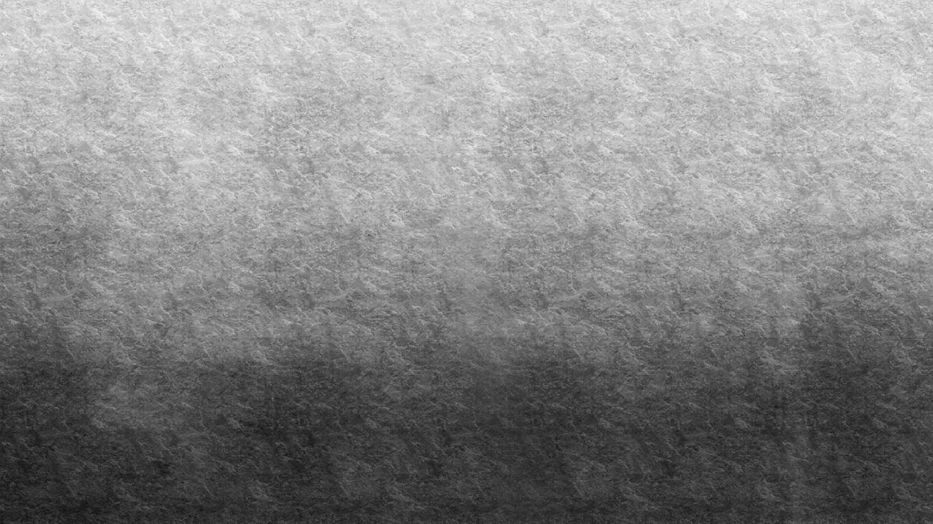

What Does Algae Look Like?

Slide 2
Notes:
Many different kinds of diatoms. Diatoms are a major group of one-celled algae, and the only organism on earth that has cell walls made up of silica. They have intricate designs and patterns and are found in fresh and saltwater environments.

Slide 3
Notes:
Zygnema is a genus of filamentous alga. The filaments can feel soapy to the touch. It can be found in stagnant or slow moving freshwater.

Slide 4
Notes:
Volvox is green algae in the family Volvocaceae that forms spherical colonies of up to 50, 000 Cells!

Slide 5
Notes:
Diatom Amphora Ehrenberg has a cell wall of overlapping halves. One of the largest genera of diatoms with over 1000 species,, Iit is found in both marine and freshwater.

Slide 6
Notes:
Spirogyra is a filamentous freshwater algae with spiral shaped chloroplasts and cylindrical cells arranged in a linear fashion.

Slide 7
Notes:
Kelp look like plants but they are really very large brown algae! Kelp forests are found along marine coastlines and in the ocean and provide a dynamic ecosystem for marine organisms.

Slide 8
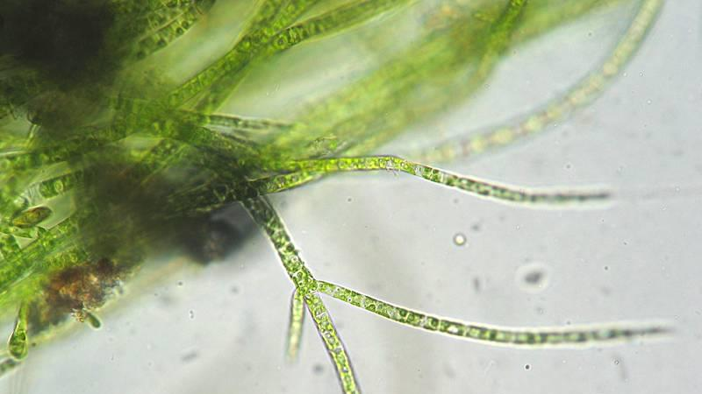
Notes:
Freshwater Stigeoclonium, a genus of green algae

Slide 9
Notes:
Nannocloropsis is a genus of algae with 6 known species. Scientist are interested in Nannochloropsis for biofuel production.

Slide 10
Notes:
Fuccus serratus is an olive-brown colored marine species alga found in northeast Atlantic ocean

Slide 11
Notes:
“diatom cake” Stephanodiscus hantzschii. This species has linear marks that radiate symmetrically from the flat center and spines on the edges.

Slide 12
Notes:
An assortment of diatoms seen through a microscope. These were found living between crystals of sea ice in McMurdo Sound, Antarctica.

Slide 13
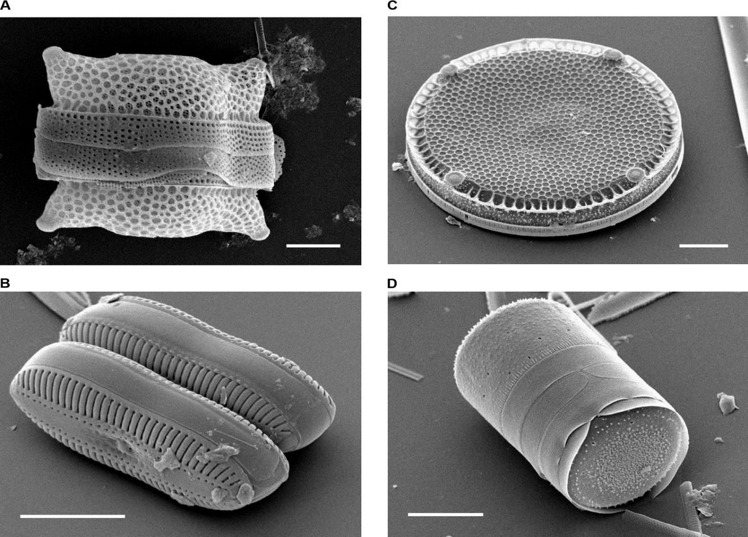
Notes:
Different types of diatoms seen through a scanning electron microscope. The white bar = 10 microns( micrometers)

Slide 14
Notes:
Sargassum is a floating brown algae found in the middle of the North Atlantic in an area known as the Sargasso Sea. In 2018 the biggest bloom of seaweed ever recorded stretched from the Gulfof Mexico to Africa!

